Slide 1
What is Operating system
An Operating System (OS) is a software that acts as an interface between computer hardware components and the user. Every computer system must have at least one operating system to run other programs. Applications like Browsers, MS Office, Notepad Games, etc., need some environment to run and perform its tasks.

Slide 2
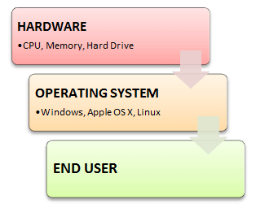
The OS helps you to communicate with the computer without knowing how to speak the computer’s language. It is not possible for the user to use any computer or mobile device without having an operating system.
Introduction to Operating System

Slide 3
Advantage of Operating System
Allows you to hide details of hardware by creating an abstraction
Easy to use with a GUI
Offers an environment in which a user may execute programs/applications
The operating system must make sure that the computer system convenient to use
Operating System acts as an intermediary among applications and the hardware components
It provides the computer system resources with easy to use format
Acts as an intermediator between all hardware’s and software’s of the system
Disadvantages of Operating System
If any issue occurs in OS, you may lose all the contents which have been stored in your system
Operating system’s software is quite expensive for small size organization which adds burden on them. Example Windows
It is never entirely secure as a threat can occur at any time

Slide 4
What is Semaphore?
Semaphore is simply a variable that is non-negative and shared between threads. A semaphore is a signaling mechanism, and a thread that is waiting on a semaphore can be signaled by another thread. It uses two atomic operations, 1) Wait, and 2) Signal for the process synchronization.
A semaphore either allows or disallows access to the resource, which depends on how it is set up.

Slide 5
Types of Semaphores
The two common kinds of semaphores are
Counting semaphores
Binary semaphores.

Slide 6
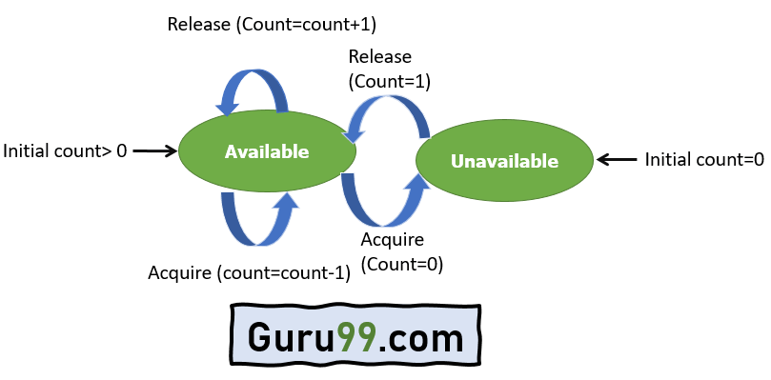
Counting Semaphores
This type of Semaphore uses a count that helps task to be acquired or released numerous times. If the initial count = 0, the counting semaphore should be created in the unavailable state.
However, If the count is > 0, the semaphore is created in the available state, and the number of tokens it has equals to its count.

Slide 7
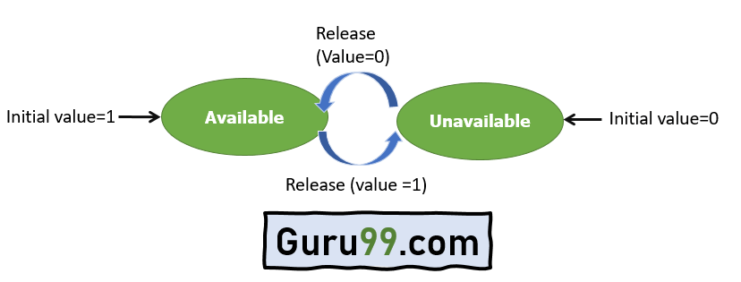
Binary Semaphores
The binary semaphores are quite similar to counting semaphores, but their value is restricted to 0 and 1. In this type of semaphore, the wait operation works only if semaphore = 1, and the signal operation succeeds when semaphore= 0. It is easy to implement than counting semaphores.

Slide 8
Wait for Operation
This type of semaphore operation helps you to control the entry of a task into the critical section. However, If the value of wait is positive, then the value of the wait argument X is decremented. In the case of negative or zero value, no operation is executed. It is also called P(S) operation.
After the semaphore value is decreased, which becomes negative, the command is held up until the required conditions are satisfied.
Copy CodeP(S)
{ while (S<=0);
S--;
}
Signal operation
This type of Semaphore operation is used to control the exit of a task from a critical section. It helps to increase the value of the argument by 1, which is denoted as V(S).
Copy CodeP(S)
{ while (S>=0);
S++;
}

Slide 9
Advantages of Semaphores
Here, are pros/benefits of using Semaphore:
It allows more than one thread to access the critical section
Semaphores are machine-independent.
Semaphores are implemented in the machine-independent code of the microkernel.
They do not allow multiple processes to enter the critical section.
As there is busy waiting in semaphore, there is never a wastage of process time and resources.
They are machine-independent, which should be run in the machine-independent code of the microkernel.
They allow flexible management of resources.
Disadvantage of semaphores
Here, are cons/drawback of semaphore
One of the biggest limitations of a semaphore is priority inversion.
The operating system has to keep track of all calls to wait and signal semaphore.
Their use is never enforced, but it is by convention only.
In order to avoid deadlocks in semaphore, the Wait and Signal operations require to be executed in the correct order.
Semaphore programming is a complicated, so there are chances of not achieving mutual exclusion.
It is also not a practical method for large scale use as their use leads to loss of modularity.
Semaphore is more prone to programmer error.
It may cause deadlock or violation of mutual exclusion due to programmer error.

Slide 10
What are OS Components
An operating system is a large and complex system that can only be created by partitioning into small pieces. These pieces should be a well-defined portion of the system, which carefully defined inputs, outputs, and functions. Although Mac, Unix, Linux, Windows, and other OS do not have the same structure, most of the operating systems share similar OS system components like File, Process, Memory, I/O device management.

Slide 11
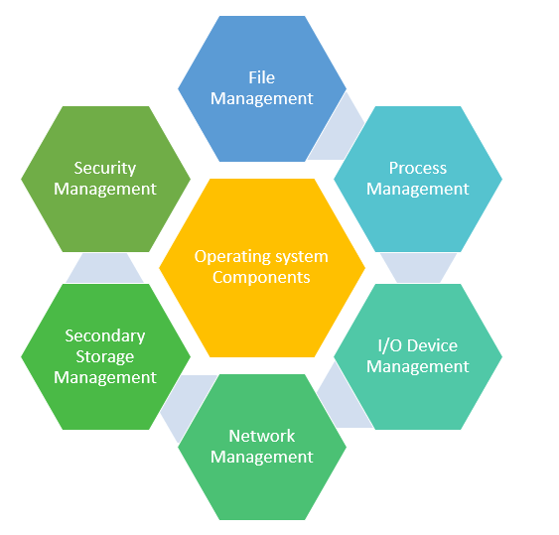


Slide 12
File Management
A file is a set of related information which is should define by its creator. It commonly represents programs, both source and object forms, and data. Data files can be numeric, alphabetic, or alphanumeric.
Process Management
The process management component is a procedure for managing the many processes that are running simultaneously on the operating system. Every software application program has one or more processes associated with them when they are running.
I/O Device Management
One of the important use of an operating system that helps you to hide the variations of specific hardware devices from the user.

Slide 13
Network Management
Network management is the process of administering and managing computer networks. It includes performance management, fault analysis, provisioning of networks, and maintaining the quality of service.
Main Memory management
Main Memory is a large array of storage or bytes, which has an address. The memory management process is conducted by using a sequence of reads or writes of specific memory addresses.
Secondary-Storage Management
The most important task of a computer system is to execute programs. These programs, along with the data, helps you to access, which is in the main memory during execution.
Security Management
The various processes in an operating system need to be secured from each other’s activities. For that purpose, various mechanisms can be used to ensure that those processes which want to operate files, memory CPU, and other hardware resources should have proper authorization from the operating system.

Slide 14
What is a Real-Time Operating System (RTOS)
Real-time operating system (RTOS) is an operating system intended to serve real time application that process data as it comes in, mostly without buffer delay. The full form of RTOS is Real time operating system.
In a RTOS, Processing time requirement are calculated in tenths of seconds increments of time. It is time-bound system that can be defined as fixed time constraints. In this type of system, processing must be done inside the specified constraints. Otherwise, the system will fail.

Slide 15
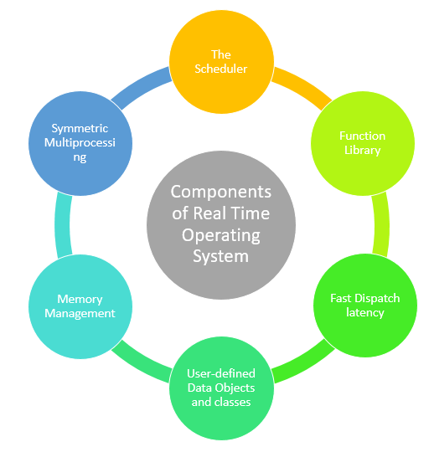

Slide 16
Component of RTOS
The Scheduler: This component of RTOS tells that in which order, the tasks can be executed which is generally based on the priority.
Symmetric Multiprocessing (SMP): It is a number of multiple different tasks that can be handled by the RTOS so that parallel processing can be done.
Function Library: It is an important element of RTOS that acts as an interface that helps you to connect kernel and application code. This application allows you to send the requests to the Kernel using a function library so that the application can give the desired results.
Memory Management: this element is needed in the system to allocate memory to every program, which is the most important element of the RTOS.
Fast dispatch latency: It is an interval between the termination of the task that can be identified by the OS and the actual time taken by the thread, which is in the ready queue, that has started processing.
User-defined data objects and classes: RTOS system makes use of programming languages like C or C++, which should be organized according to their operation.

Slide 17
Types of RTOS
Three types of RTOS systems are:
Hard Real Time :
In Hard RTOS, the deadline is handled very strictly which means that given task must start executing on specified scheduled time, and must be completed within the assigned time duration.
Example: Medical critical care system, Aircraft systems, etc.
Firm Real time:
These type of RTOS also need to follow the deadlines. However, missing a deadline may not have big impact but could cause undesired affects, like a huge reduction in quality of a product.
Example: Various types of Multimedia applications.
oft Real Time:
Soft Real time RTOS, accepts some delays by the Operating system. In this type of RTOS, there is a deadline assigned for a specific job, but a delay for a small amount of time is acceptable. So, deadlines are handled softly by this type of RTOS.
Example: Online Transaction system and Livestock price quotation System.

Slide 18
Features of RTOS
Here are important features of RTOS:
Occupy very less memory
Consume fewer resources
Response times are highly predictable
Unpredictable environment
The Kernel saves the state of the interrupted task ad then determines which task it should run next.
The Kernel restores the state of the task and passes control of the CPU for that task.

Slide 19
Applications of Real Time Operating System
Real-time systems are used in:
Airlines reservation system.
Air traffic control system.
Systems that provide immediate updating.
Used in any system that provides up to date and minute information on stock prices.
Defense application systems like RADAR.
Networked Multimedia Systems
Command Control Systems
Internet Telephony
Anti-lock Brake Systems
Heart Pacemaker

Slide 20
Disadvantages of RTOS
Here, are drawbacks/cons of using RTOS system:
RTOS system can run minimal tasks together, and it concentrates only on those applications which contain an error so that it can avoid them.
RTOS is the system that concentrates on a few tasks. Therefore, it is really hard for these systems to do multi-tasking.
Specific drivers are required for the RTOS so that it can offer fast response time to interrupt signals, which helps to maintain its speed.
Plenty of resources are used by RTOS, which makes this system expensive.
The tasks which have a low priority need to wait for a long time as the RTOS maintains the accuracy of the program, which are under execution.
Minimum switching of tasks is done in Real time operating systems.
It uses complex algorithms which is difficult to understand.
RTOS uses lot of resources, which sometimes not suitable for the system.

